Slide 1
CS6140 Project
Stock Price Prediction for NVIDIA (NVDA)
Shengyi Qian
Zi Wang

Slide 2
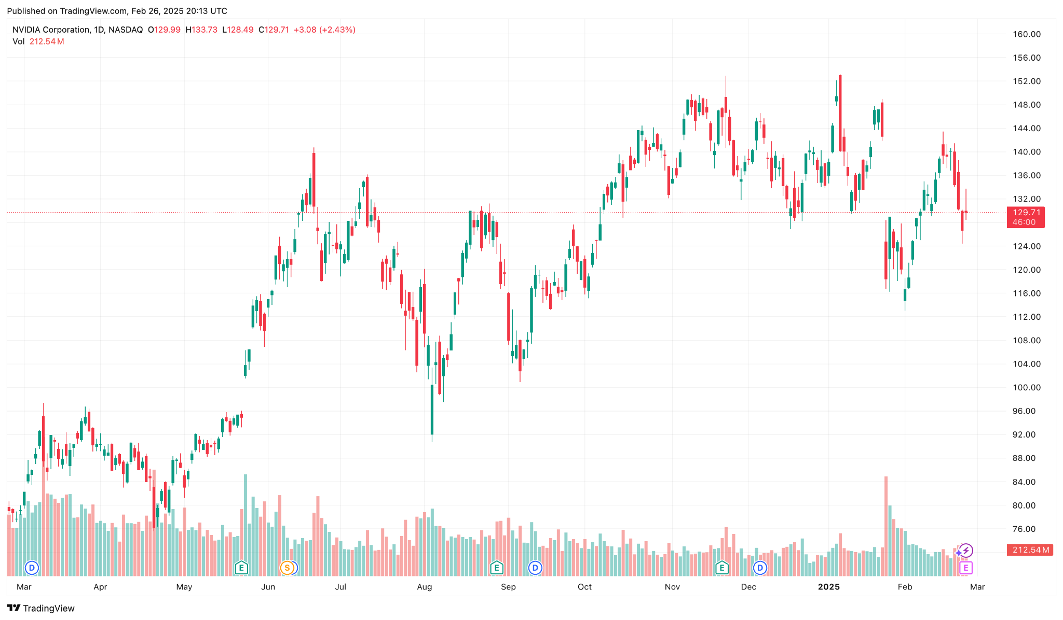

NVIDIA Stock Price Prediction
NVIDIA, a major player in the semiconductor industry, its stock price exhibits significant fluctuations influenced by rapid technological advancements and market dynamics, making it interesting and challenging to forecast its movements.

Slide 3
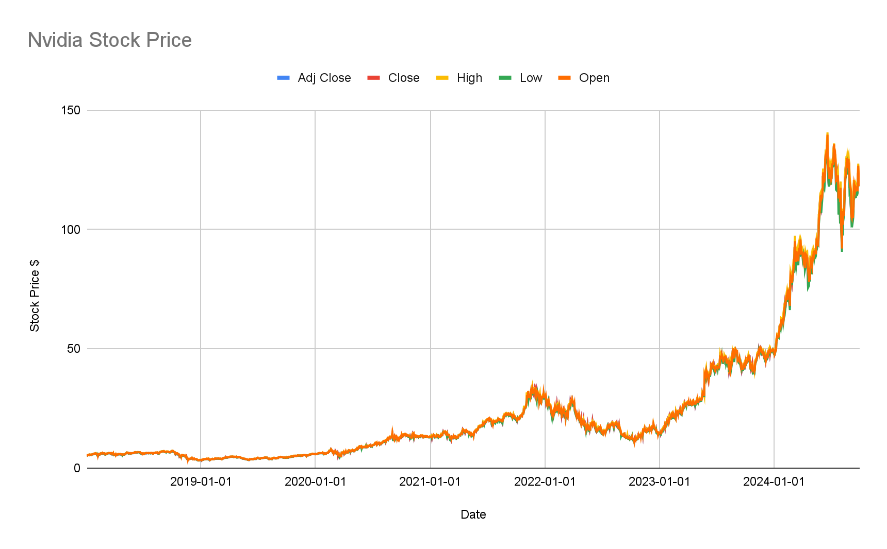
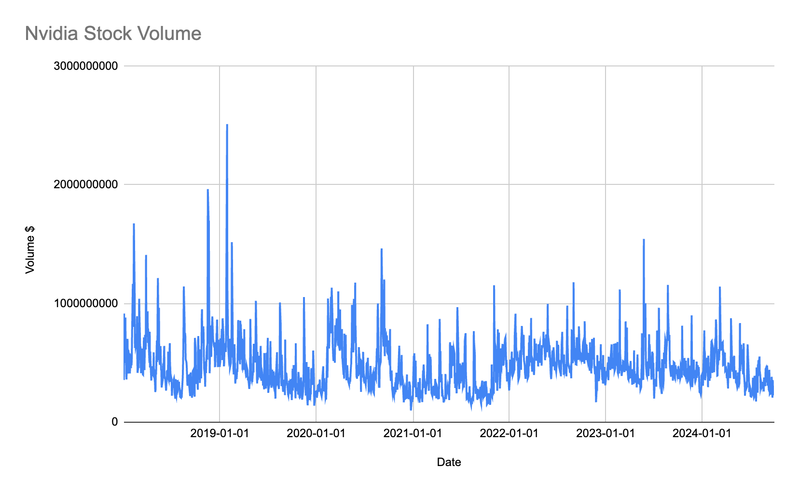
Dataset
Dataset source: Kaggle (https://www.kaggle.com/datasets/muhammaddawood42/nvidia-stock-data/data)
1,697 daily records of NVIDIA stock data from 2018-01-02 to 2024-09-30
Features: Date, Open, High, Low, Close, Adjusted Close, and Volume
Additional features: 10-day and 50-day moving averages and daily returns

Slide 4
Regression Models
Split the dataset chronologically into 80% training and 20% testing sets to avoid lookahead bias.
A PLR approach with degree 2 polynomial features for a baseline comparison.
A Random Forest regressor that captures complex patterns while reducing overfitting.
A DNN regressor built using PyTorch to capture non-linear relationships.
Potentially a LSTM regressor also implemented in PyTorch to explicitly model temporal dependencies in the data.
Model performance will be assessed using MSE and R², and visualizations will be generated to compare actual versus predicted closing prices.

Slide 5
Thank you!

